Slide 1

Machine Learning
Session 1

Slide 2




Session 1
Topics
Introduction to Machine Learning.
History of Machine Learning.
Why ML.
Applications of ML.
Algorithms on ML.
------BREAK-----
Python tutorial
Model representation, Hypothesis function, Cost Function(Mean square Error).
Grow Through

Slide 3
Session 1
Intro to ML
the study of computer algorithms that improve automatically through experience.
Machine Learning is a subset of artificial intelligence.
Field of study that gives computers the ability to learn without being explicitly programmed.
Grow Through

Slide 4
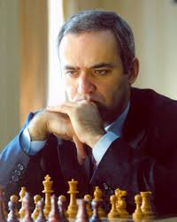
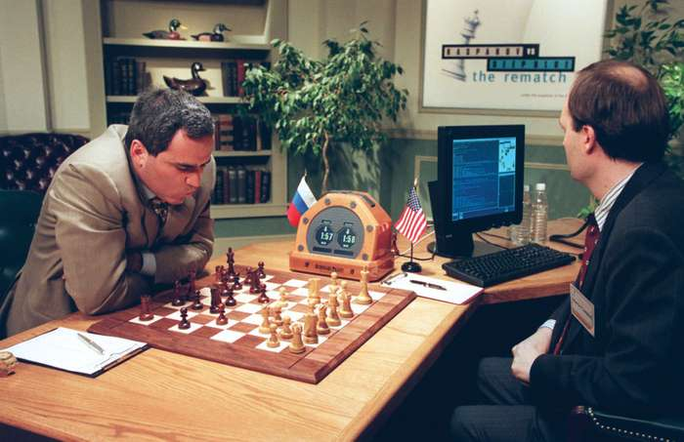
Session 1
Intro to ML
The struggle between computer of IBM and Garry Kasparov(the youngest world champion in chess) in 1997 and the computer could beat Kasparov after 5 times of lose and studying more than (7000000) game of chess .
Grow Through

Slide 5
Session 1
Intro to ML
Tom Mitchell (1998) Well-posed Learning Problem: A computer program is said to learn from experience E with respect to some task T and some performance measure P, if its performance on T, as measured by P, improves with experience E.
Grow Through

Slide 6
Session 1
Intro to ML
EX. Suppose your email program watches which emails you do or do not mark as spam, and based on that learns how to better filter spam. What is the task T in this setting?
Classifying emails as spam or not spam.
Watching you label emails as spam or not spam.
The number (or fraction) of emails correctly classified as spam/not spam.
None of the above—this is not a machine learning problem.
T
E
P
Grow Through

Slide 7
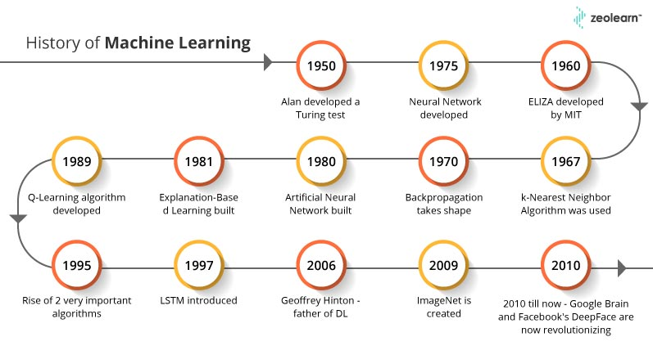
Session 1
History of ML
Grow Through

Slide 8
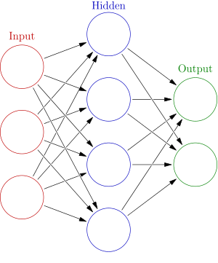
Session 1
Artificial neural networks
Computing systems vaguely inspired by the biological neural networks that constitute animal brains.
The original goal of the ANN approach was to solve problems in the same way that a human brain would.
Used on a variety of tasks(computer vision, speech recognition, machine translation, social network filtering, playing board and video games and medical diagnosis).
Grow Through

Slide 9
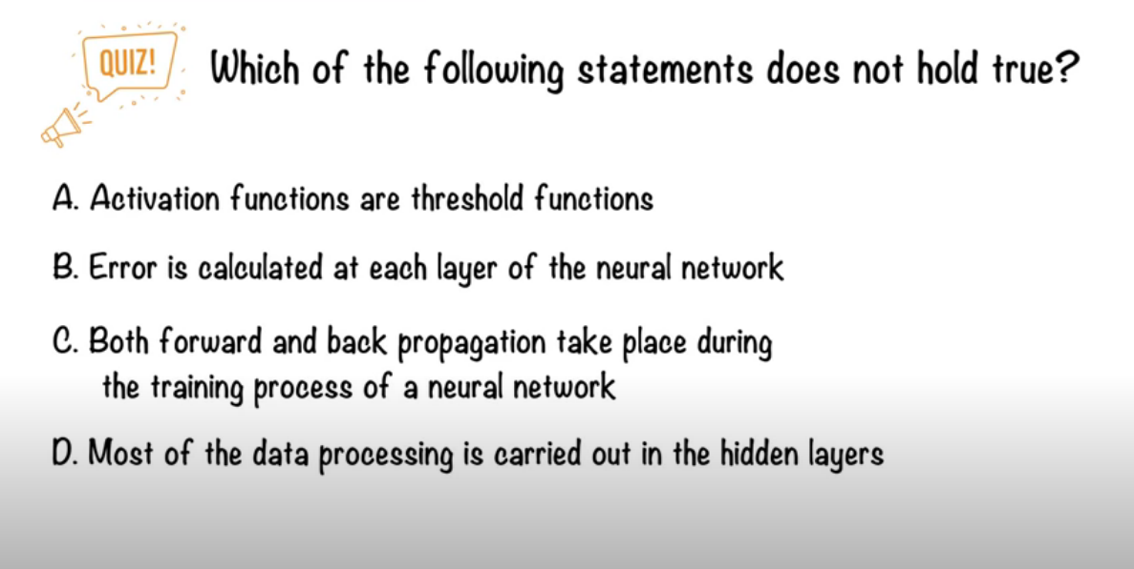
Session 1
Grow Through

Slide 10
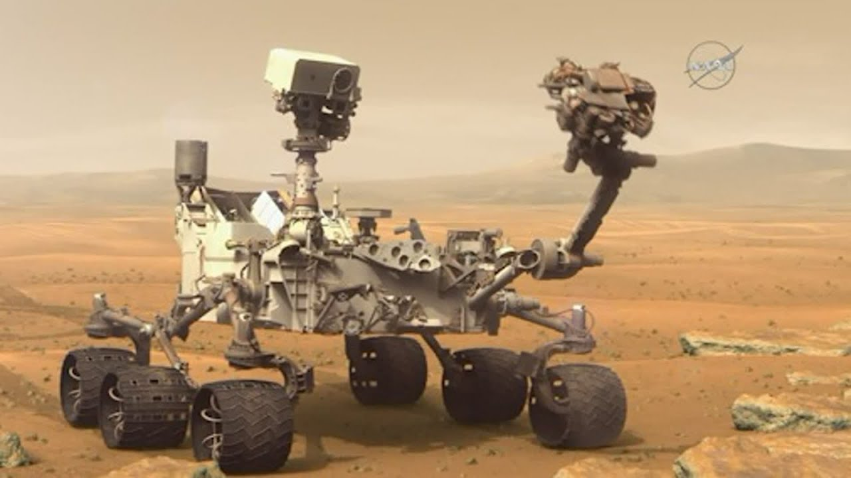
Session 1
Why ML !?
Machine learning is useful when human expertise doesn’t exist like navigation in mars.
Solutions changes in time like in communication networks base stations.
Human can’t express their expertise like blind people use speech recognition.
Grow Through

Slide 11
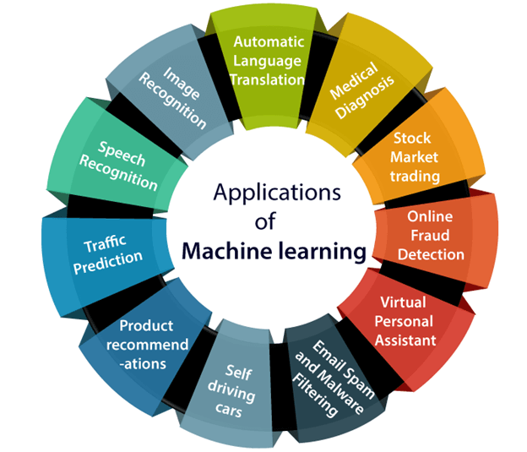
Session 1
Applications of ML
We are using machine learning in our daily life even without knowing it such as Google Maps, Google assistant, Alexa, etc.
Grow Through

Slide 12
Session 1
Algorithms
Supervised learning
Unsupervised learning
Others: Reinforcement learning, recommender systems.
Also talk about: Practical advice for applying learning algorithms.
Grow Through

Slide 13
Session 1
Supervised learning
In supervised learning, we are given a data set and already know what our correct output should look like, having the idea that there is a relationship between the input and the output.
Supervised learning problems are categorized into "regression" and "classification" problems. In a regression problem, we are trying to predict results within a continuous output, meaning that we are trying to map input variables to some continuous function. In a classification problem, we are instead trying to predict results in a discrete output. In other words, we are trying to map input variables into discrete categories.
Grow Through

Slide 14
Session 1
Supervised learning
Example 1:
Given data about the size of houses on the real estate market, try to predict their price. Price as a function of size is a continuous output, so this is a regression problem.
We could turn this example into a classification problem by instead making our output about whether the house "sells for more or less than the asking price." Here we are classifying the houses based on price into two discrete categories.
Grow Through

Slide 15
Session 1
Supervised learning
Example 2:
Regression - Given a picture of a person, we have to predict their age on the basis of the given picture
Classification - Given a patient with a tumor, we have to predict whether the tumor is malignant or benign.
Grow Through

Slide 16
Quiz:
You’re running a company, and you want to develop learning algorithms to address each of two problems.
Problem 1: You have a large inventory of identical items. You want to predict how many of these items will sell over the next 3 months.
Problem 2: You’d like software to examine individual customer accounts, and for each account decide if it has been hacked/compromised.
Should you treat these as classification or as regression problems?
Treat both as classification problems.
Treat problem 1 as a classification problem, problem 2 as a regression problem.
Treat problem 1 as a regression problem, problem 2 as a classification problem.
Treat both as regression problems.
Grow Through

Slide 17
Session 1
Unsupervised learning
Unsupervised learning allows us to approach problems with little or no idea what our results should look like. We can derive structure from data where we don't necessarily know the effect of the variables.
We can derive this structure by clustering the data based on relationships among the variables in the data.
With unsupervised learning there is no feedback based on the prediction results.
Grow Through

Slide 18
Session 1
Unsupervised learning
Types:
Clustering: Take a collection of 1,000,000 different genes, and find a way to automatically group these genes into groups that are somehow similar or related by different variables, such as lifespan, location, roles, and so on.
Non-clustering: The "Cocktail Party Algorithm", allows you to find structure in a chaotic environment. (i.e. identifying individual voices and music from a mesh of sounds at a cocktail party).
Grow Through

Slide 19
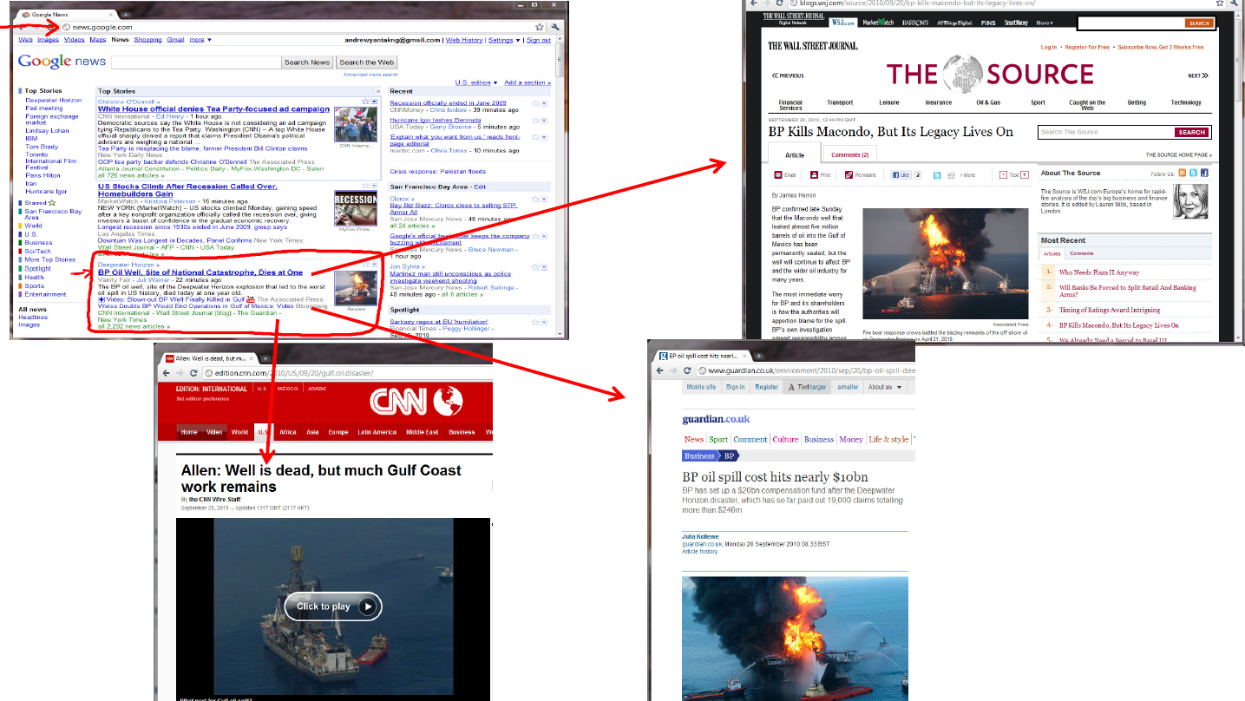
Example:
Grow Through

Slide 20
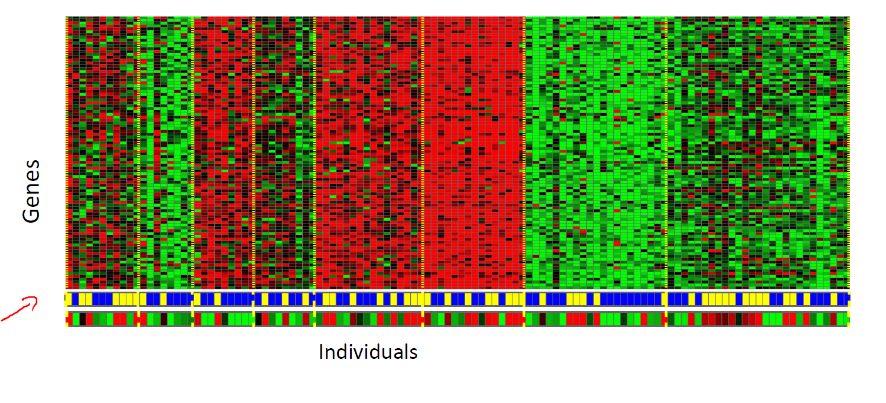
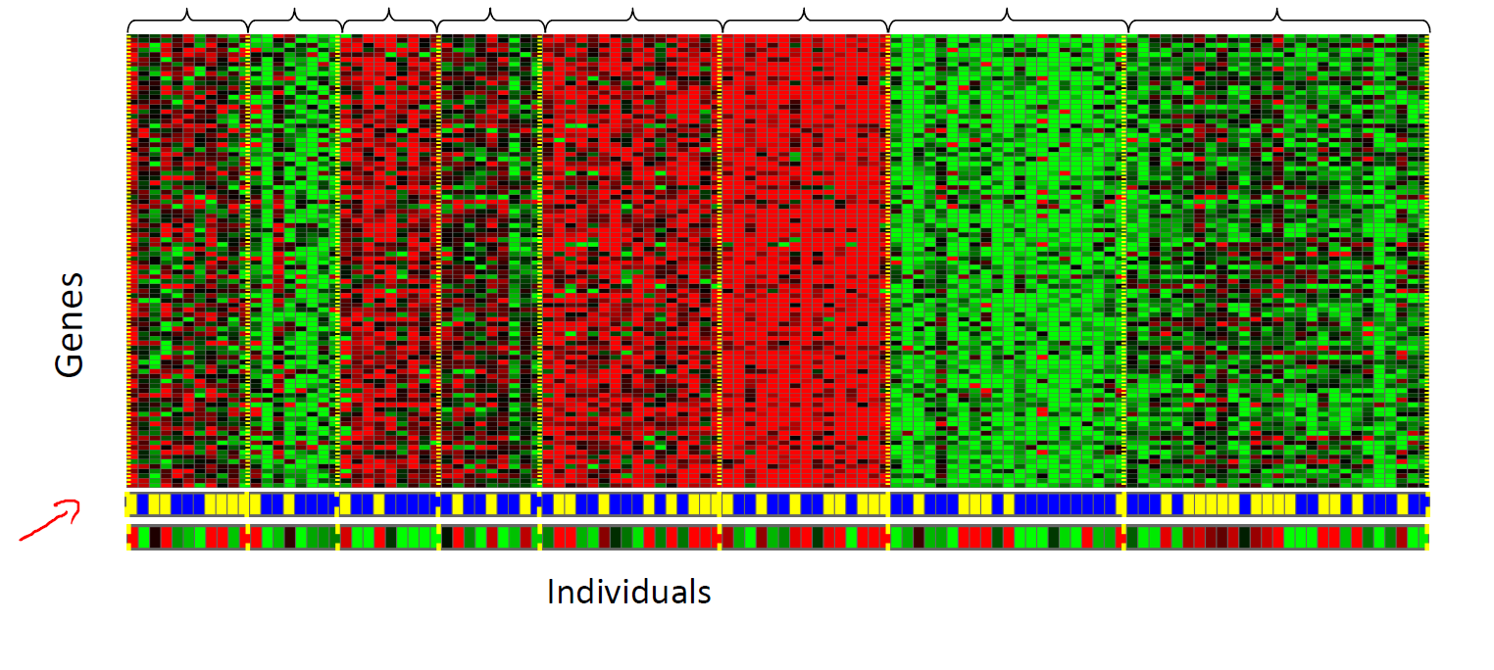
Example:
Grow Through

Slide 21
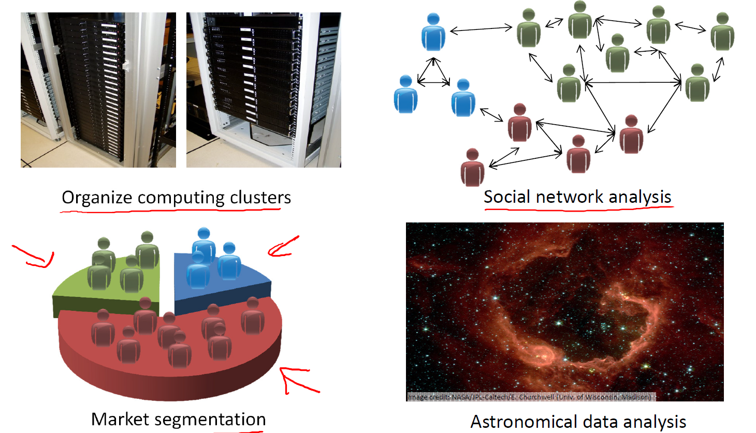
Grow Through

Slide 22
Quiz:
Of the following examples, which would you address using an
unsupervised learning algorithm? (Check all that apply.)
Given email labeled as spam/not spam, learn a spam filter.
Given a set of news articles found on the web, group them into set of articles about the same story.
Given a database of customer data, automatically discover market
Given a dataset of patients diagnosed as either having diabetes or not, learn to classify new patients as having diabetes or not.
Grow Through

Slide 23
Title
Subtitle
Text
Grow Through

